Slide 1
DEMO 6
Petra Puumala

Slide 2
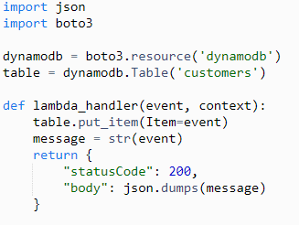
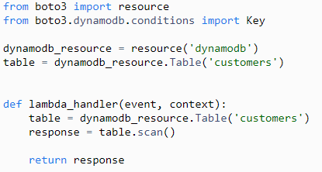
Function
I decided to do this task with AWS
Customer register system
Stores a customer into Dynamo DB table
Creates a list of all customers from Dynamo DB table
adding customer scanning all customers

Slide 3
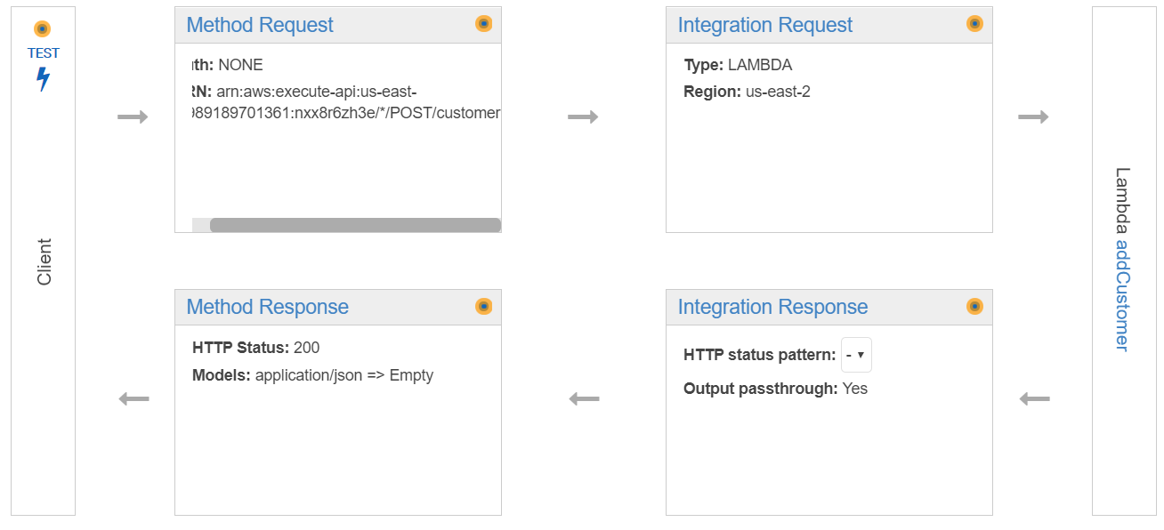

Slide 4
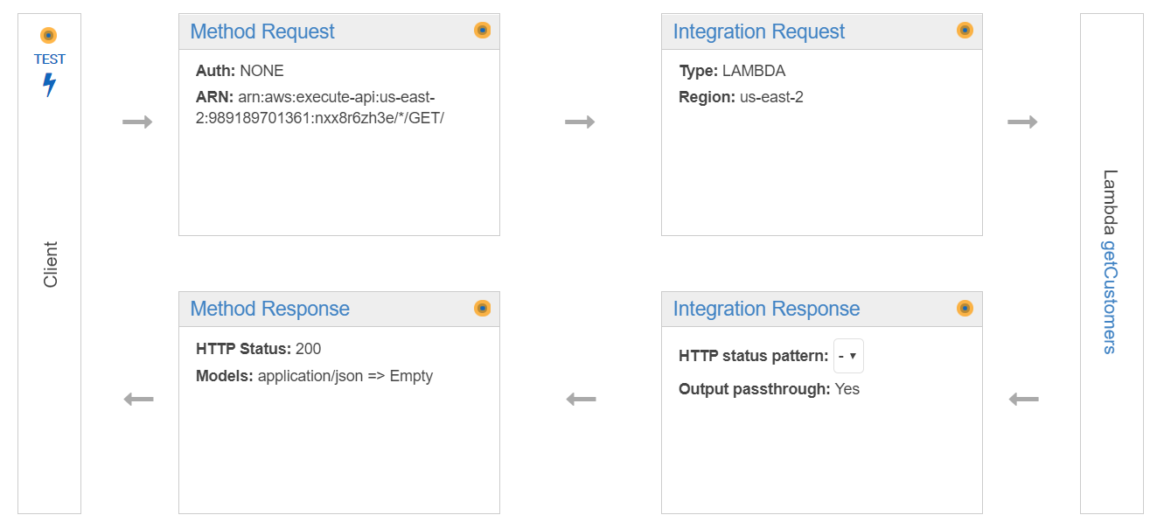

Slide 5
API
GET
POST:
{
”customer_id”: ”<id>”,
”customer_name”: ”<name>”
}

Slide 6
Problems
I tried also to implement delete-function, but I wasn’t able to get it work

Slide 7
DEMO
https://nxx8r6zh3e.execute-api.us-east-2.amazonaws.com/beta

